Slide 1

Презентация к уроку английского языка в 3 классе “Funny animals”
Составитель: Банина М.А., учитель английского языка МБОУ СШ №5 г.Павлово

Slide 2


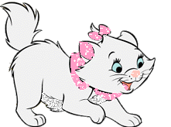



Funny animals

Slide 3

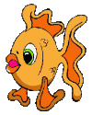
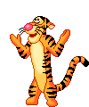



Listen and watch
Mind the grammar
Learn the words
Funny riddles
Sing a song!
A poem
Homework
Nice flowers

Slide 4


Slide 5

A cat.
My cat is white,
My cat is fat,
I like my cat
It is my pet.

Slide 6
Listen and watch
Mind the grammar
Learn the words
Funny riddles
Sing a song!
A poem
Homework
Nice flowers

Slide 7
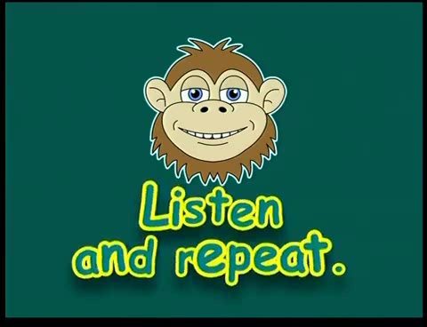

Slide 8

Find pairs
nose
tail
body
eyes
ears
head
legs
ноги
тело
хвост
голова
глаза
уши
нос

Slide 9


Slide 10

The sheep has got
fat
/
thin
body and
thin
/
small legs.
The cow is
happy
/
funny
and it has got a
small
/
mouth.
big

Slide 12
Listen and watch
Mind the grammar
Learn the words
Funny riddles
Sing a song!
A poem
Homework
Nice flowers

Slide 13
It
has
got a big mouth.
I
have
got a small nose.

Slide 14
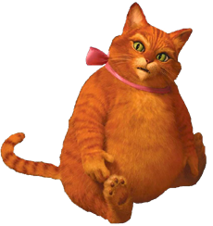
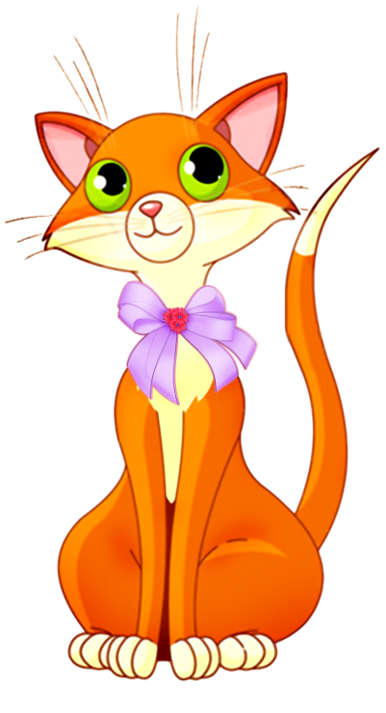
It has got a small head.
It has not got a small head.
Have you got a big head?
Yes, I have.
No, I have not.

Slide 15
Evaluate the project
It has got a small head.
Аккуратность.
Правильность составления загадки.
Правильность выбора картинок.
It has not got a small head.
Have you got a big head?
Yes, I have.
No, I have not.

Slide 16
Homework
Придумать и написать загадку.
Упр.5 стр.75

Slide 17
Listen and watch
Mind the grammar
Learn the words
Funny riddles
Sing a song!
A poem
Homework
Nice flowers

Slide 18



Complete the sentences
Make a bouquet.
Я узнал …
Я повторил …
Мне было интересно …
Мне было не понятно …
Меня удивило …
Мне было трудно …
Very good!
OK.
Not very good.

Slide 19
You work well! Thank you for the lesson!

